Slide 1
Before we start...
Recording - yes
Share Slides - yes
Questions in chat

Slide 2
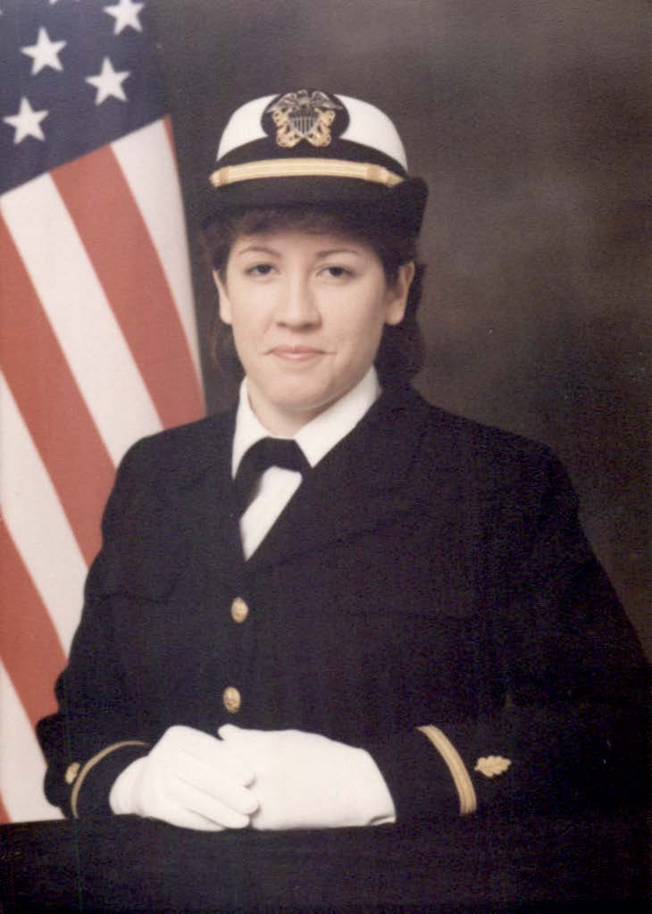
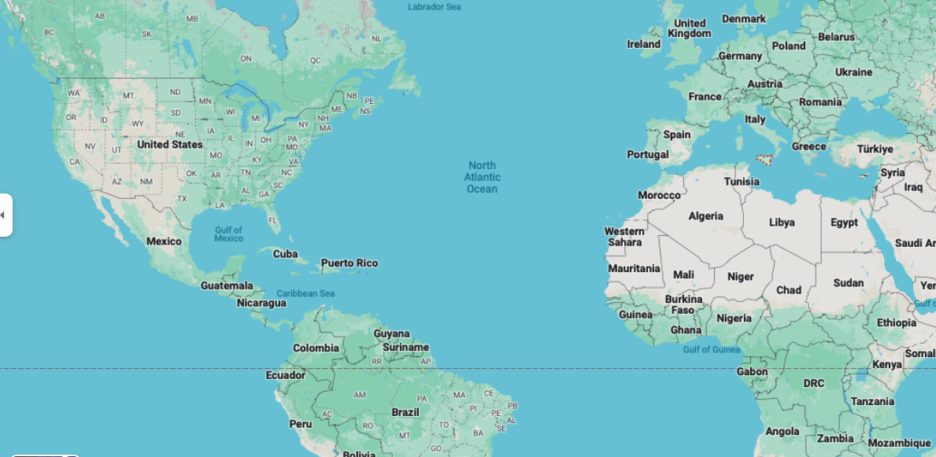

Slide 3
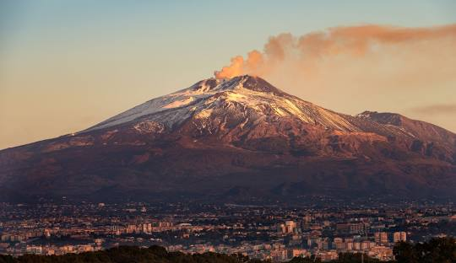

Slide 4
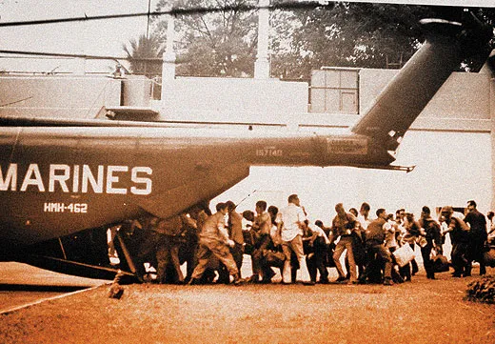

Slide 5
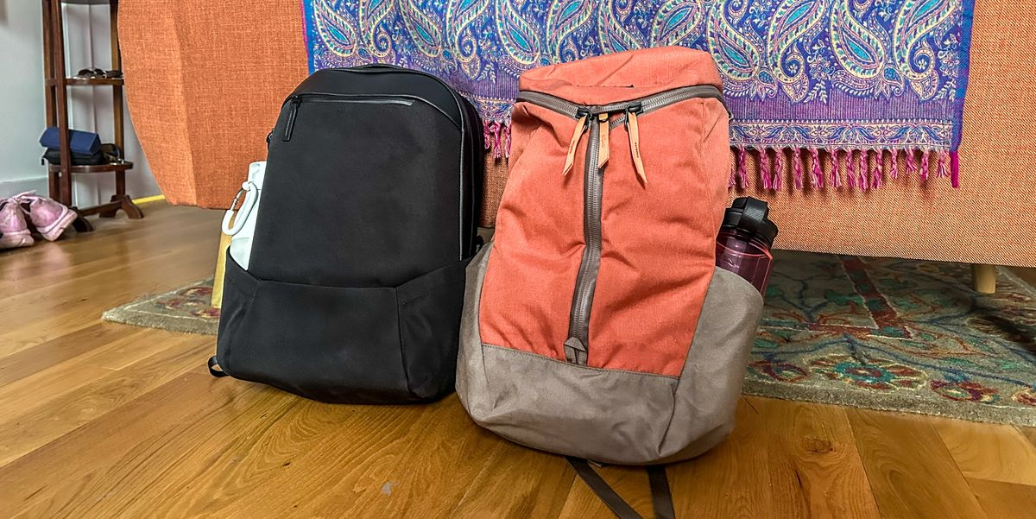

Slide 7
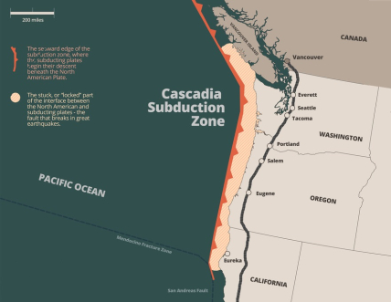
2011 - Left Sicily
2014 - Seattle
2016
“Cascadia Rising”
exercise at a Hub
WHOA…

Slide 8
History of the Hubs

Slide 9
We are social creatures.
After a disaster, neighbors will naturally gather in open spaces
and work together
to make the situation better.

Slide 10
Information
Neighbors
Need…
Education
Stuff
People Skills

Slide 11
Information
Neighbors
Need…
Education
Stuff
People Skills
Greeter

Slide 12
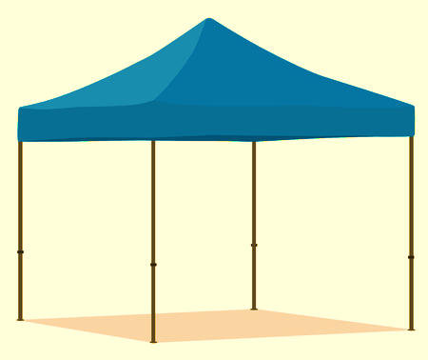
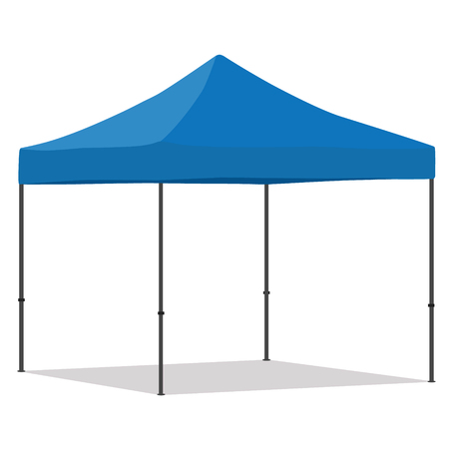

Slide 13
Neighbors…
Information
Information
Map
Whiteboards
Information Manager
Education
Education
Greeter
Stuff
Supplies
People Skills
Volunteers

Slide 14
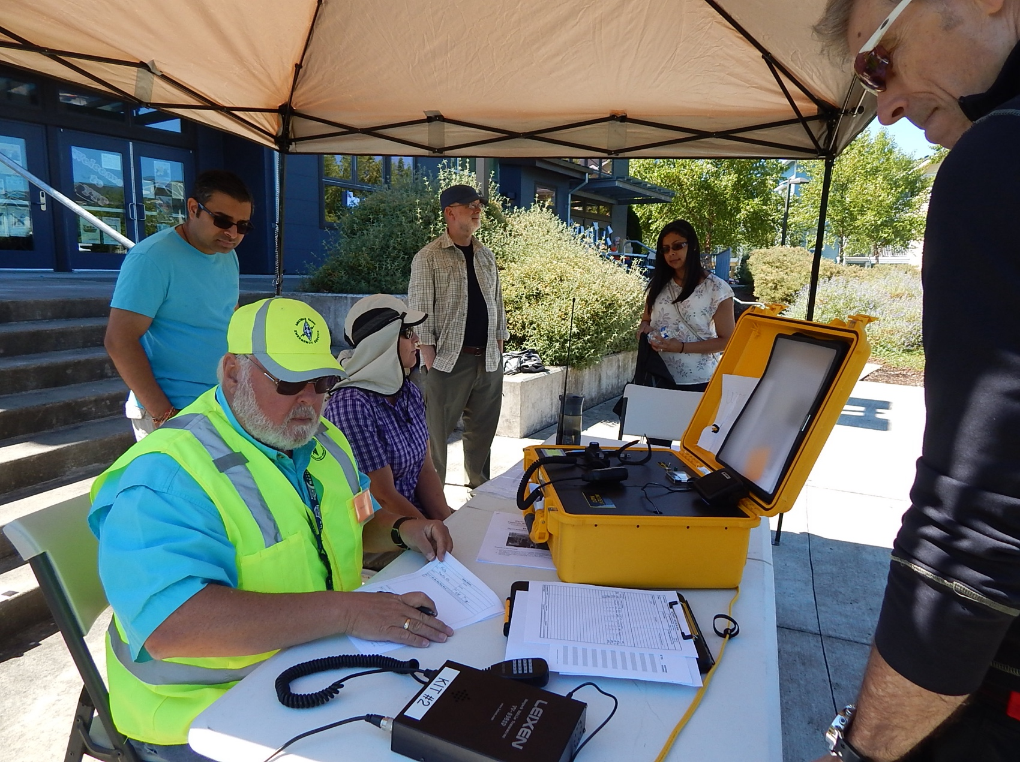
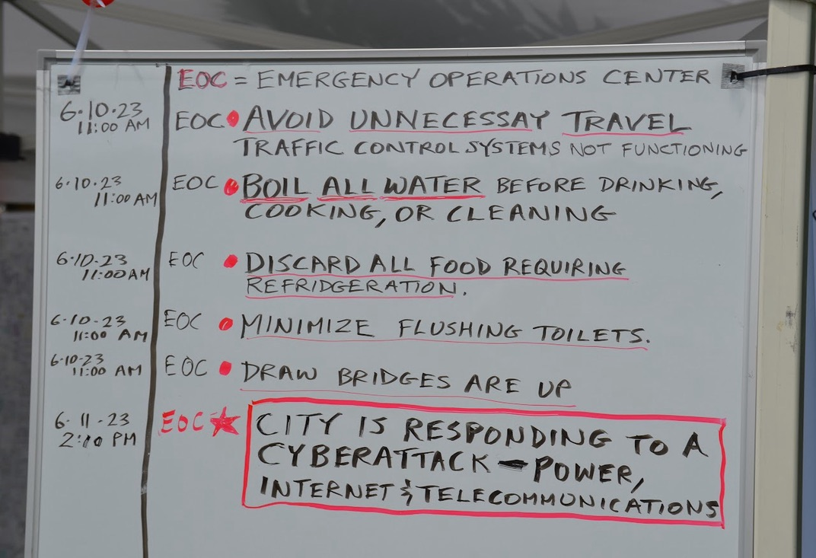

Slide 15
Neighbors…
Information
Information
Information Manager
Education
Education
Posters
Book
Educator
Greeter
Stuff
Supplies
People Skills
Volunteers

Slide 16
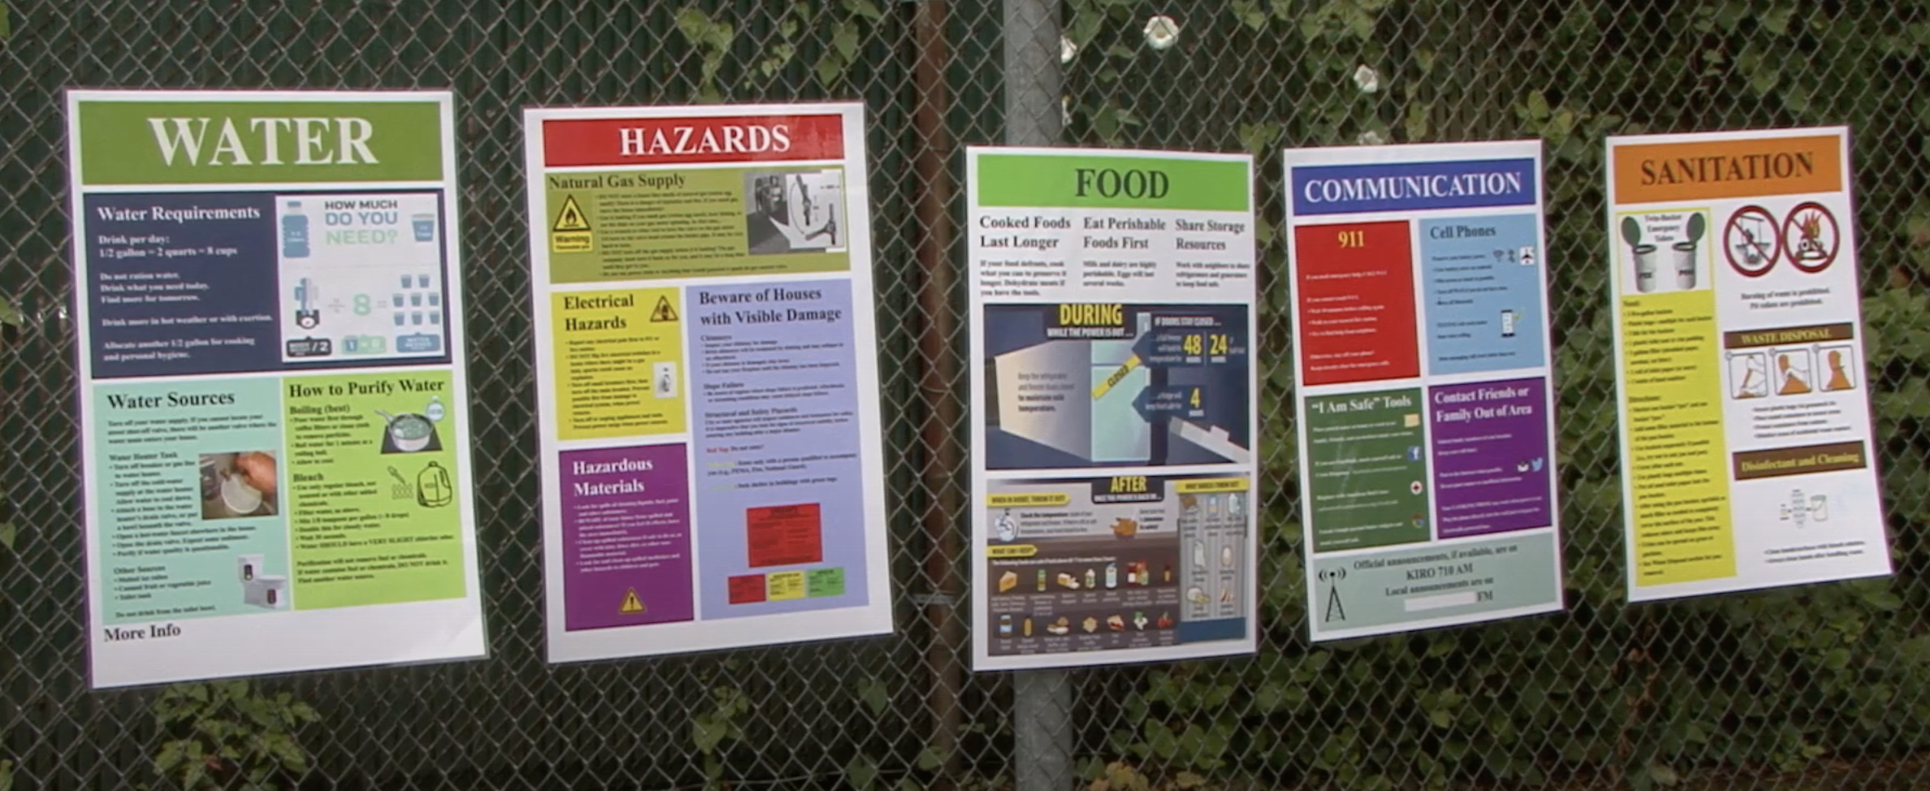

Slide 17
Neighbors…
Information
Information
Information Manager
Education
Education
Educator
Greeter
Stuff
Supplies
People Skills
Food/Water
Have Need
Shovels
Have Need
Supply Manager
Volunteers

Slide 18
Experience the paper system
“Have / Need form”

Slide 19
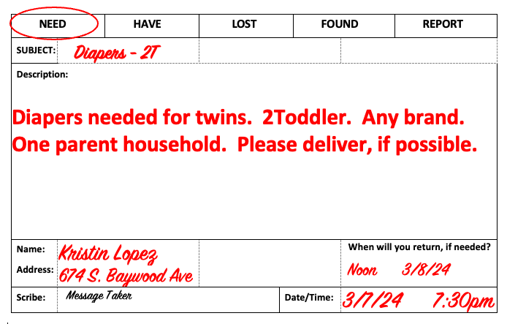

Slide 20
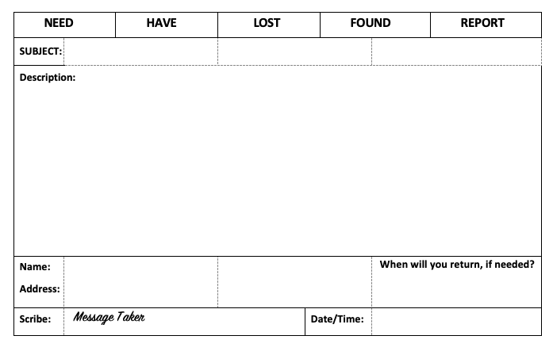

Slide 21
Neighbors…
Information
Information
Information Manager
Education
Education
Educator
Greeter
Stuff
Supplies
People Skills
Supply Manager
Volunteers
Plumber
Have Need
Translator
Have Need
Volunteer
Coordinator

Slide 22
Experience the paper system
“Volunteer form”

Slide 23
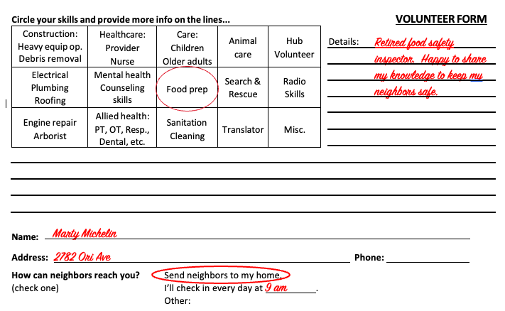

Slide 24
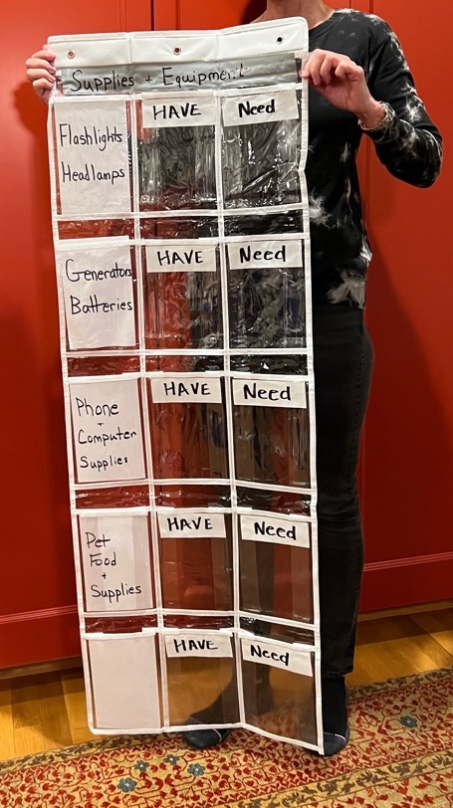
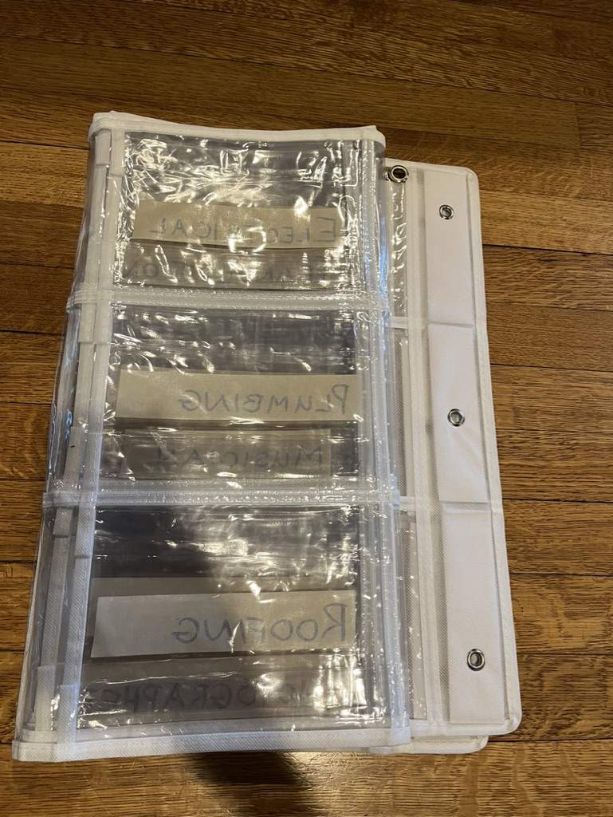

Slide 25
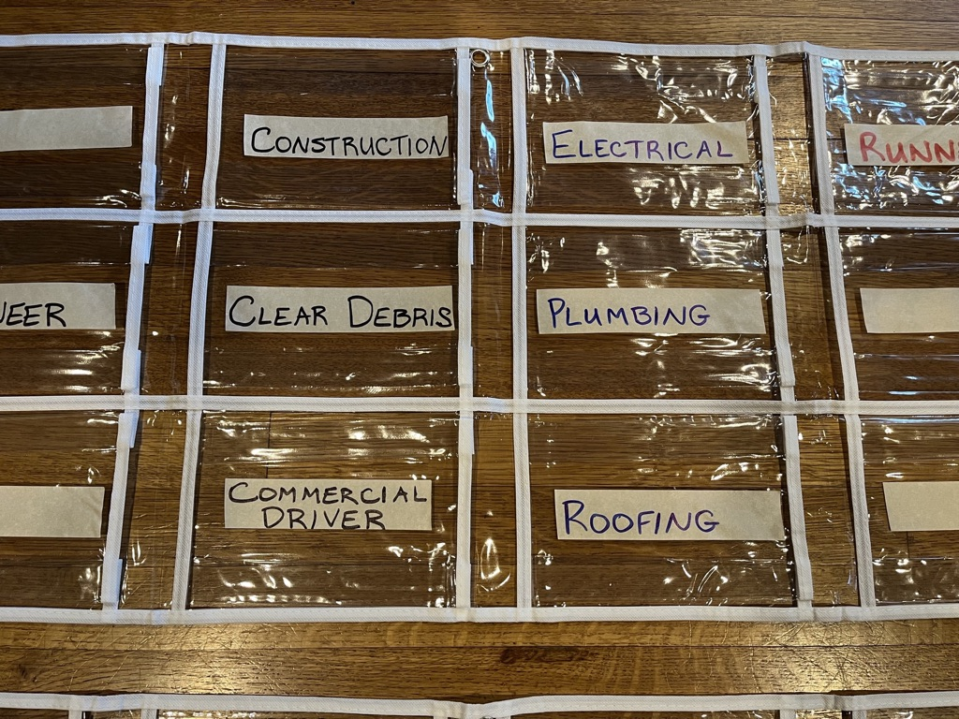

Slide 26
Neighbors…
Information
Information
Map
Whiteboards
Information Manager
Education
Education
Posters
Book
Educator
Greeter
Stuff
Supplies
People Skills
Food/Water
Have Need
Shovels
Have Need
Hub
Manager
Supply Manager
Volunteers
Plumber
Have Need
Translator
Have Need
Volunteer
Coordinator

Slide 27
Neighbors…
Information
Information
Map
Whiteboards
Information Manager
Education
Education
Posters
Book
Educator
Greeter
Supplies
Food/Water
Have Need
Shovels
Have Need
Hub
Manager
Supply Manager
Message
Taker
Volunteers
Plumber
Have Need
Translator
Have Need
Volunteer
Coordinator

Slide 28
Managing information
the LOW TECH way…

Slide 29
Scenarios
If you were the Greeter, what would you do with this neighbor?

Slide 30
Neighbors…
Information
Information
Map
Whiteboards
Information Manager
Education
Education
Posters
Book
Educator
Greeter
Supplies
Food/Water
Have Need
Shovels
Have Need
Hub
Manager
Supply Manager
Message
Taker
Volunteers
Plumber
Have Need
Translator
Have Need
Volunteer
Coordinator
Radio Assistant
Other HUBs
City Officials
Radio
Operator

Slide 31
Neighbors…
Information
Information
Map
Whiteboards
Information Manager
Education
Education
Posters
Book
Educator
Greeter
Supplies
Food/Water
Have Need
Shovels
Have Need
Hub
Manager
Supply Manager
Message
Taker
Volunteers
Plumber
Have Need
Translator
Have Need
Volunteer
Coordinator
Medical Officer
Visiting Nurse
Reunification Officer
Radio Assistant
Other HUBs
City Officials
Radio
Operator

Slide 32
Neighbors…
Information
Information
Map
Whiteboards
Information Manager
Education
Education
Posters
Book
Educator
Greeter
Supplies
Food/Water
Have Need
Shovels
Have Need
Hub
Manager
Supply Manager
Message
Taker
Volunteers
Plumber
Have Need
Translator
Have Need
Volunteer
Coordinator
Medical Officer
Visiting Nurse
Reunification Officer
Radio Assistant
Other HUBs
City Officials
Radio
Operator

Slide 33
12 roles

Slide 34
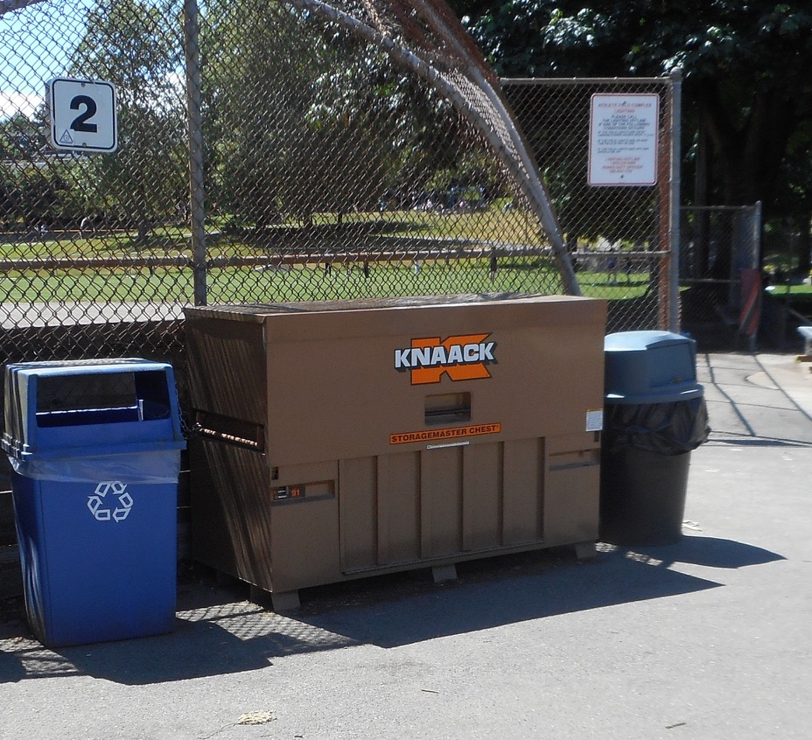

Slide 35
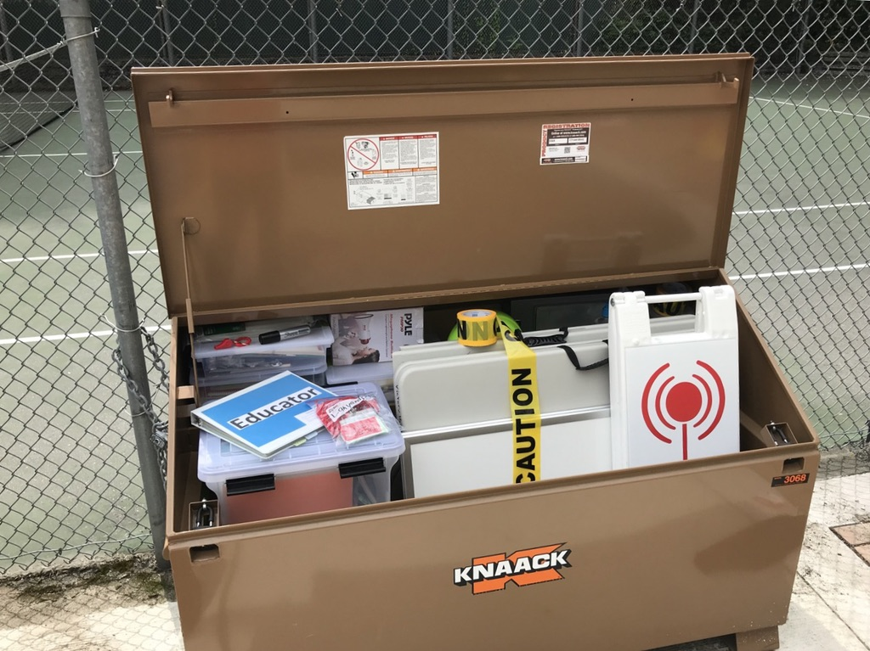

Slide 36
Storage box and the gear
~$5,000
Smaller box – less expensive

Slide 37
Please note:
Legible handwriting is critical!
We don’t operate after dark. No Power.
Don’t allow neighbors to drop off gear, food, blankets, etc. at the Hub.
Be mindful of the one-to-many issue.

Slide 38
Moving forward…
Does this system make sense for your community and your hazards?
No need to recreate the wheel.
Job descriptions
Forms
List of gear

