Slide 1
Light Search and Rescue Operations
CERT Basic Training
Unit 5

Slide 2
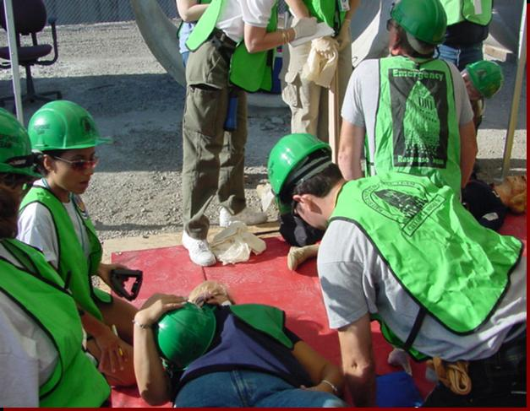
Search and Rescue
Consists of three separate operations
  Sizeup: Using 9-step, continual model
  Search: Locating survivors and documenting
  Rescue: Extricating survivors

Slide 3
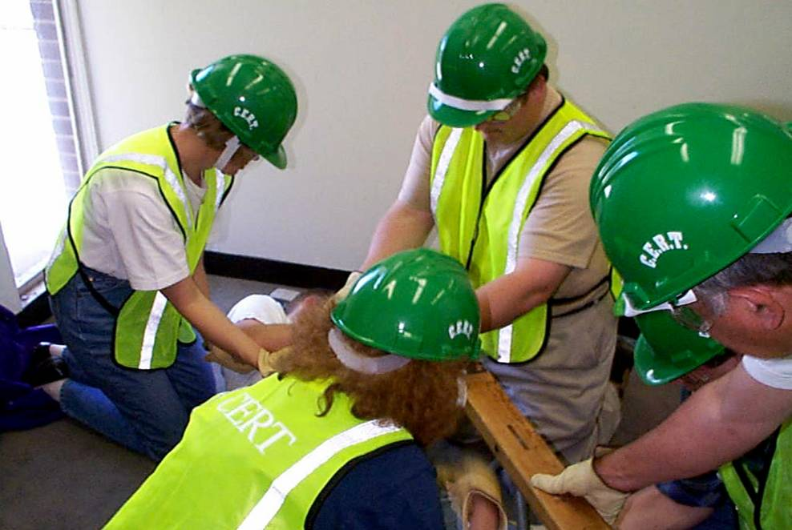
Deciding to Attempt Rescue
Decision based on three factors
  The risks involved for the rescuer
  Greatest good for the greatest number
  Resources and manpower available

Slide 4
Goals of Search and Rescue
Rescue greatest number in shortest amount of time
Get walking wounded out first
Rescue lightly trapped survivors next
Keep the rescuer safe

Slide 5
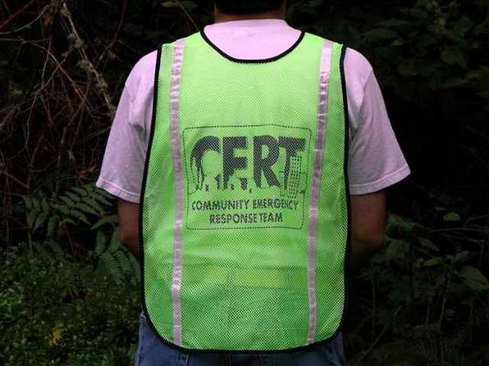
Effective Search and Rescue
Depends on:
  Effective sizeup
  Rescuer safety
  Survivor safety

Slide 6
Unit Objectives
Identify sizeup requirements
Describe most common search techniques
Use safe techniques for debris removal
Use safe techniques for survivor extrication
Describe ways to protect rescuers

Slide 7
Unit Topics
Safety During Search and Rescue Operations
Conducting Interior and Exterior Searches
Conducting Rescue Operations
Notes:
6

Slide 8
CERT Sizeup
Gather Facts
Assess Damage
Consider Probabilities
Assess Your Situation
Establish Priorities
Make Decisions
Develop Plan of Action
Take Action
Evaluate Progress
REMEMBER: CERT SIZEUP IS A CONTINUAL PROCESS
Notes:
7

Slide 9
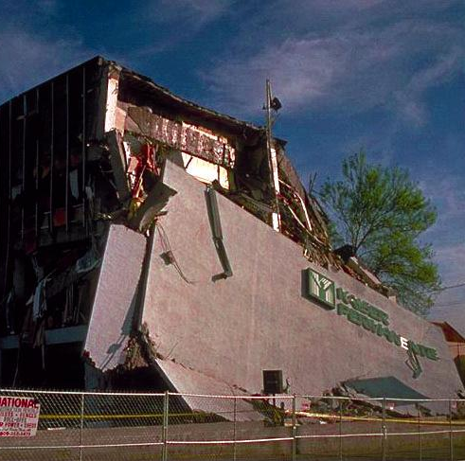
Sizeup – Step 1
Gather Facts
Time of event and day of the week
Construction type/terrain
Occupancy
Weather
Hazards

Slide 10
Sizeup: Step 2
Assess and Communicate Damage
The CERT mission changes if:
  Damage is light
  Damage is moderate
  Damage is heavy
Notes:
9

Slide 11
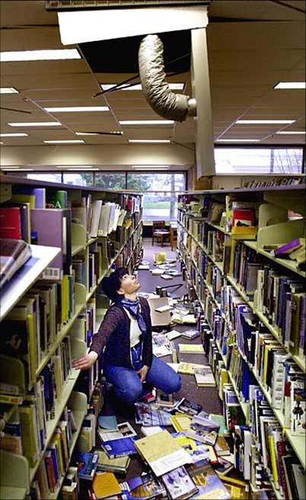
Light Damage
Superficial
Broken windows
Superficial cracks or
breaks in wall surface
Minor damage to the
interior contents
Safe to enter and remain
Notes:
10

Slide 12
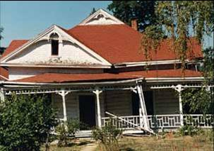
Moderate Damage
Visible signs of damage
Decorative work damaged or fallen
Many visible cracks
or breaks in wall
Major damage to interior contents
Building still on foundation
Enter only to save lives
Notes:
11

Slide 13
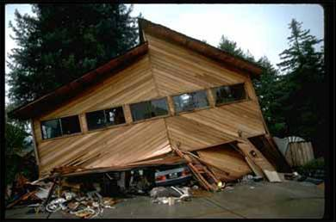
Heavy Damage
Partial or total collapse
Tilting
Obvious structural instability
Building off foundation
Do not enter a building with heavy damage under any circumstances
Notes:
12

Slide 14
Sizeup: Step 3
Consider Probabilities
How stable is the situation?
What else could go wrong?
What does it mean for the search and rescue?

Slide 15
Sizeup: Step 4
Assess Your Situation
Is the situation safe enough to continue?
What risks will rescuers face?
What resources are needed?
What resources are available?
Notes:
14

Slide 16

Rescue Resources
Personnel
  Firefighters
  Police
  Nurse, M.D.
  Contractor
Tools
  Crowbars
  Auto jacks
  Chainsaws
Equipment
Notes:
15

Slide 17
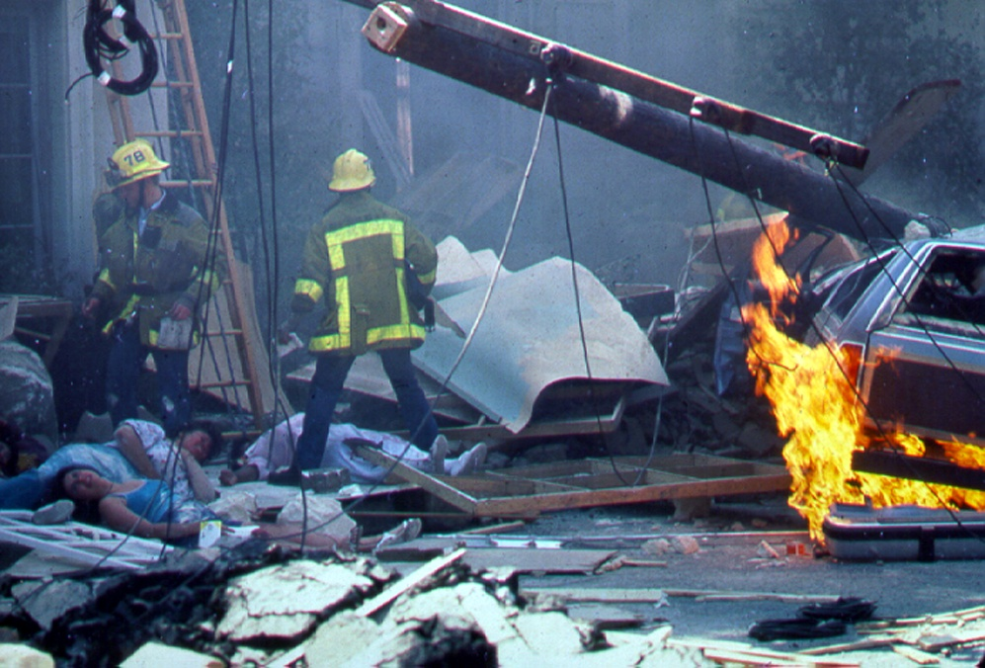
Sizeup: Step 5
Establish Priorities
What should be done?
In what order?
How to rescue the greatest number in the shortest amount of time?
Notes:
16

Slide 18
Sizeup: Step 6
Make Decisions
Keep in mind:
  Safety of CERT members
  Life safety for survivors and others
  Protection of the environment
  Protection of property
Notes:
17

Slide 19
Sizeup: Step 7
Develop Plan of Action
Focus operation on established priorities and decisions
Provide for documentation to give to responding agencies
Provide for documentation to become part of CERT records
Notes:
18

Slide 20
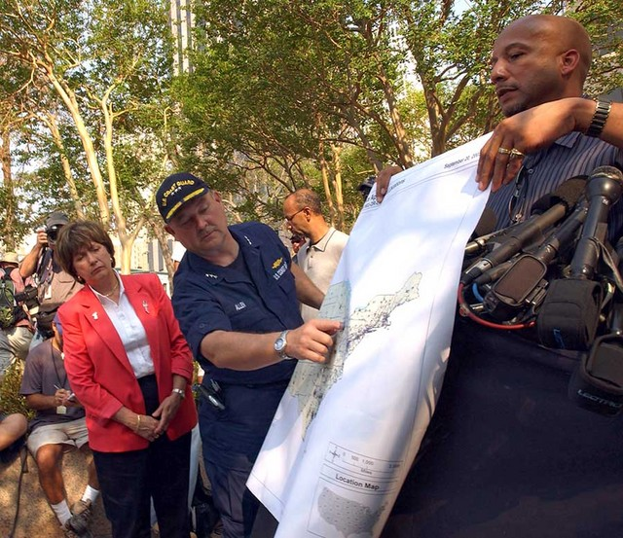
Sizeup: Step 8
Take Action
Based on plan developed during
Step 7
Notes:
19

Slide 21
Sizeup: Step 9
Evaluate Progress
Most critical step
Monitor plan’s effectiveness and safety
REMEMBER: CERT SIZEUP IS A CONTINUAL PROCESS

Slide 22
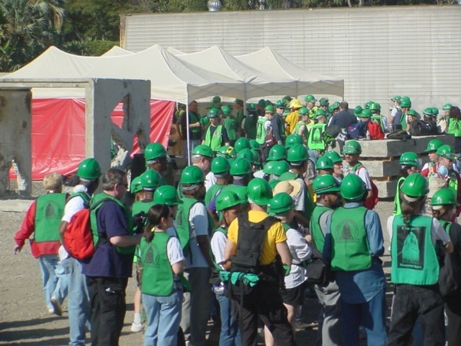
Specific Safety Considerations
Make rescuer safety primary concern
Use a buddy system
Be alert for hazards
Use safety equipment
Rotate teams
Notes:
21

Slide 23
Structural Voids
If you see collapsed floors or walls, get out!
X
X
X
X
Pancake Void
X
X
X
‘V’ Void
X
= Voids
Lean-to Void
Notes:
22

Slide 24
Individual Voids
Spaces where survivors may seek protection
  Bathtubs
  Underneath desks
  Inside cabinets
  Under/next to beds
  Inside closets

Slide 25
Search Markings
Upon entering search area:
  Make a slash
  Enter info
Date
Time In
Time Out
CERT
I.D.
Areas Searched
Upon leaving search area:
  Complete ‘X’
  Enter info
Survivors
Notes:
24

Slide 26
Search Markings
What information do you mark?
Date
Time In
Time Out
CERT I.D.
Areas
Searched
Victims
Notes:
25

Slide 27
Search Markings
Example:
2/15/08
In: 1430
Out: 1515
FL 1-2 searched
Stairs to FL-3 unsafe
CERT-23
2L
Moved to
CERT-23 med
ops
Notes:
26

Slide 28
Search Methodology
Call out to survivors, “If anyone can hear my voice, come here”
Ask any survivors who do respond for more information about the building or others who may be trapped
Survivors might be in shock or confused
Notes:
27

Slide 29
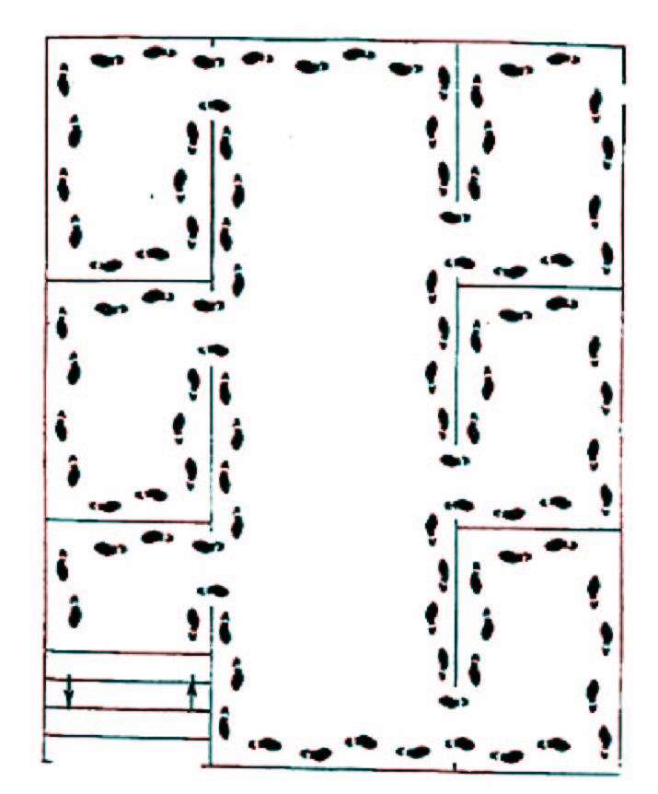
Search Methodology
Bottom-up/top-down for a multi-story building
Right wall/left wall for a single floor
Stop frequently to listen
Notes:
28

Slide 30
Search Methodology
Stop frequently to listen for:
  Tapping
  Movement
  Voices
Notes:
29

Slide 31
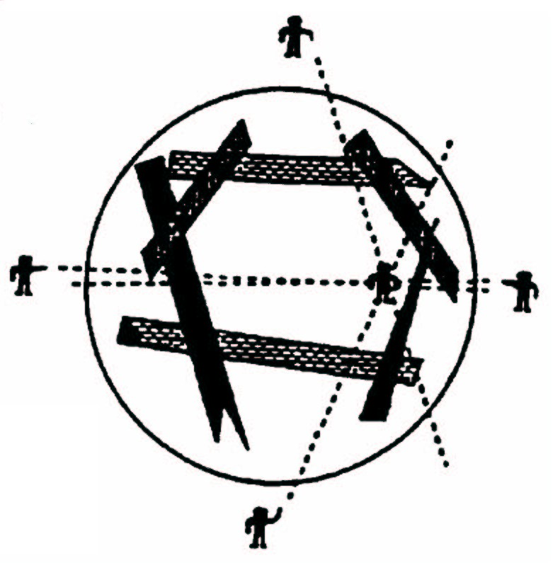
Search Methodology
Triangulation allows rescuers to view a location from several perspectives
Notes:
30

Slide 32
Search Methodology
Keep records of rescued survivors and of those who remain trapped or are dead
Report information to emergency services personnel
Notes:
31

Slide 33
Exterior Search
Set up a grid search
  Set distance between searchers according to visibility and debris
  Overlap patterns for full coverage
  Search in as straight a line as possible
  Mark areas that have been searched
Notes:
32

Slide 34
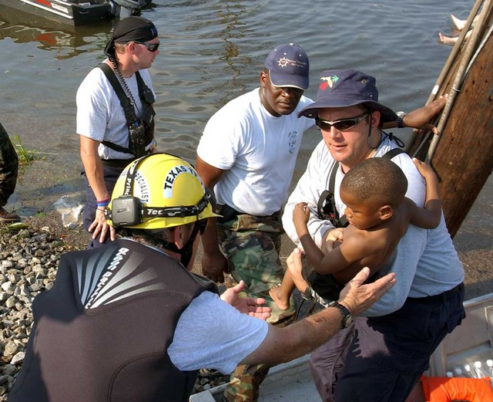
Rescue Operations
Remove objects and debris to free survivors and create safe rescue environment
Triage survivors
Remove survivors
Remove debris
Notes:
33

Slide 35
Creating a Safe Environment
Maintain rescuer safety
Triage in lightly and moderately damaged buildings
Evacuate survivors as quickly as possible
Notes:
34

Slide 36
Precautions to Minimize Risk
Know your limitations
Follow safety procedures
Remove debris by:
  Leveraging
  Cribbing
Notes:
35

Slide 37
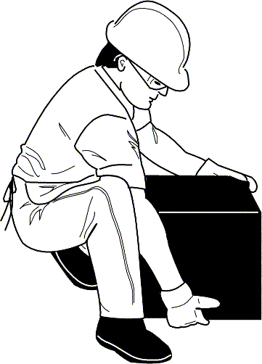
Proper Lifting Procedures
Back straight
Bend knees
Keep load close to body
Push up with legs
Notes:
36

Slide 38
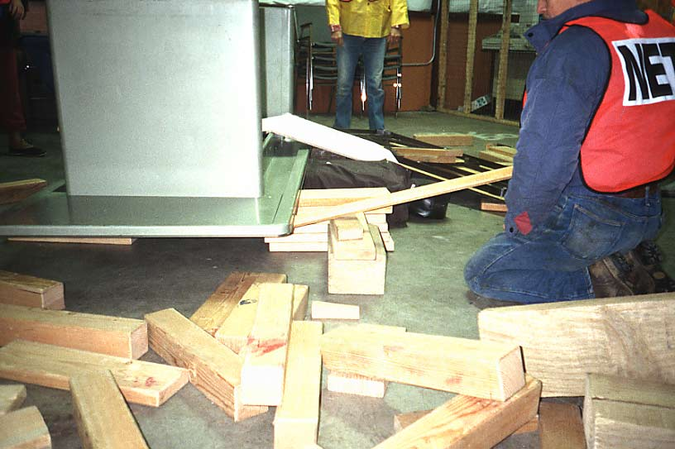
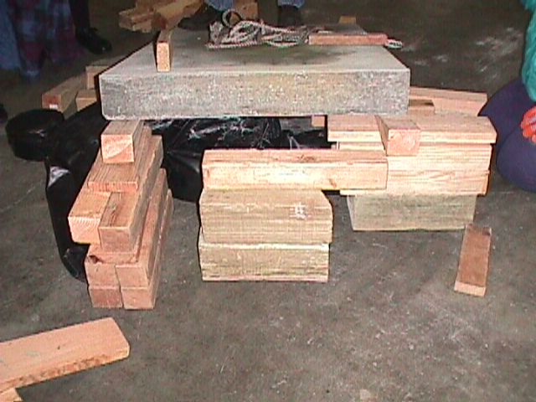
Leveraging and Cribbing
For heavy lifting
Performed in tandem
Helps extricate survivors
Various materials and objects may be used
Notes:
37

Slide 39
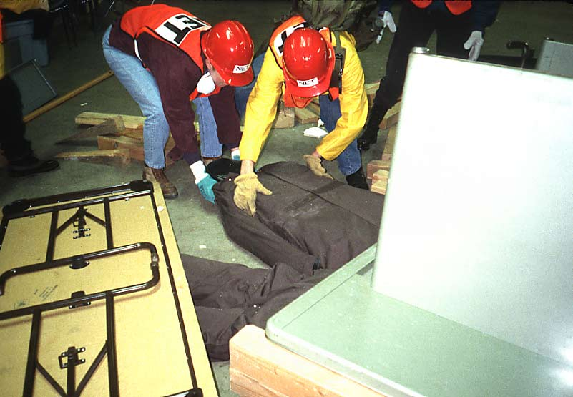
Two Types of Removal
Self removal or assist
Lifts and drags
Notes:
38

Slide 40
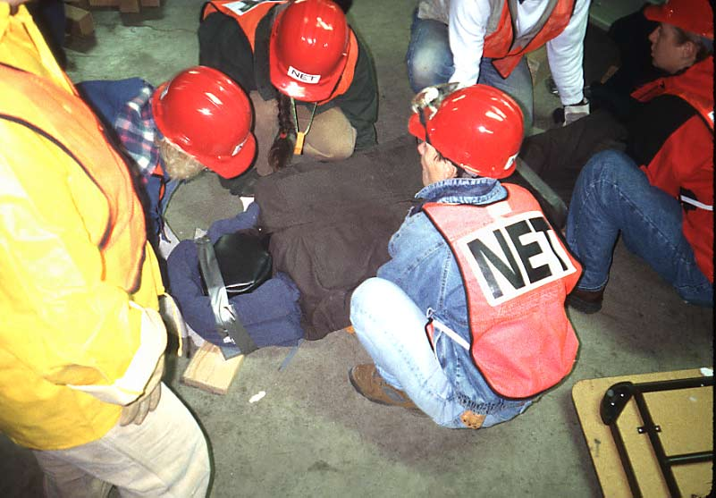
Which Extrication Method?
General stability of the immediate environment
Number of rescuers available
Strength and ability of the rescuers
Condition of survivor
Notes:
39

Slide 41
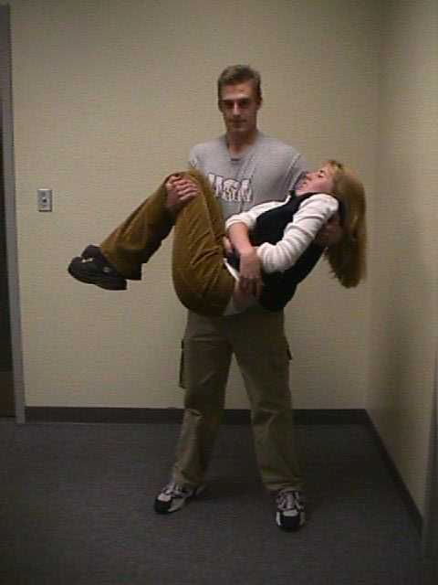
One-Person Arm Carry
Lift around survivor’s back and under knees
Lift survivor by keeping your own back straight and lifting with legs
Notes:
40

Slide 42
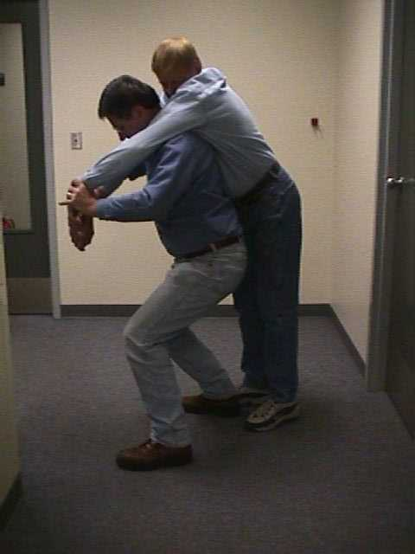
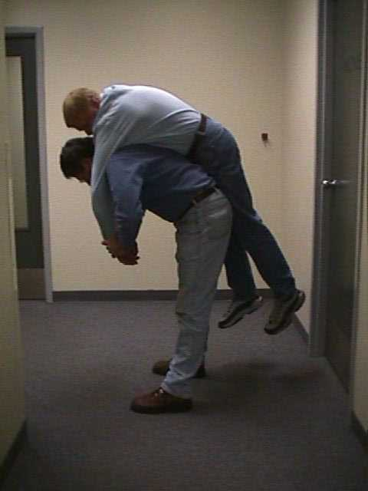
Pack-Strap Carry
Notes:
41

Slide 43
Two-Person Carry
Notes:
42

Slide 44
Chair Carry
Notes:
43

Slide 45
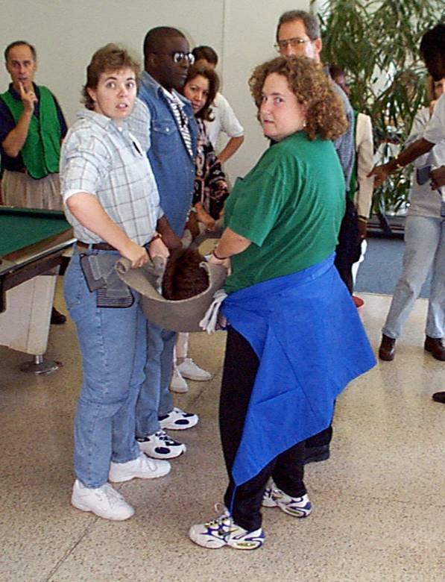
Blanket Carry
Notes:
44

Slide 46
Log Rolling
Notes:
45

Slide 47
Blanket Drag
Notes:
46

Slide 48
Unit Summary
You should know:
  How to decide whether to attempt rescue
  The objectives of interior and exterior search and rescue
  How to perform search and rescue sizeup
  Building markings
  Rescue functions
  How to remove debris
  How to extricate survivors
Notes:
47

Slide 49
Homework Assignment
Read unit to be covered in next session
Bring necessary supplies to next session
Wear appropriate clothes to next session
Notes:
48

